Slide 1
Secure data hiding in images using steganography
CAPSTONE PROJECT
Presented By: Katuri Rammurti Kayarwar
Student Name : Katuri Rammurti Kayarwar
College Name : Kakatiya Institute of Technology and Science - Warangal
Department : Computer Science with specialization in artificial intellegence and machine learning

Slide 2
OUTLINE
Problem Statement
Technology used
Wow factor
End users
Result
Conclusion
Git-hub Link
Future scope

Slide 3
Problem Statement
Traditional encryption methods make data protection evident, increasing the likelihood of interception. This project leverages image steganography to conceal secret messages within images using Least Significant Bit (LSB) encoding. By keeping the message invisible, it ensures secure and discreet communication. This method strengthens data security without drawing unnecessary attention.

Slide 4
Technology used
The required technologies used in this project are:
1. Python 3.x – The programming language used to implement the steganography logic.
2. OpenCV (`cv2`)– A library for image processing, used to read, modify, and save images.
3. Least Significant Bit (LSB) Encoding– A steganography technique to embed messages into image pixel values.
4. OS Module – Used to handle file operations, such as opening the encrypted image automatically.

Slide 5
Wow factors
1. Stealthy Security – Unlike traditional encryption, this method does not attract attention, reducing the risk of interception.
2. Creative & Unique – Hiding messages in images adds an intriguing and innovative twist to data security.
3. Lightweight & Simple – No need for complex cryptography algorithms—just modify pixel values subtly.
4. Cross-Platform Compatibility – The encrypted image can be shared like any normal image without raising suspicion.
5. Fun & Practical– It can be used for secure communication, watermarking, or even digital signatures.

Slide 6
End users
Cybersecurity Professionals – For secure and discreet communication.
Journalists & Activists – To share sensitive information without detection.
Government & Military – For covert communication and intelligence sharing.
Businesses & Corporations – To protect confidential data from competitors.
General Users – Anyone needing a private and secure way to exchange messages.

Slide 7
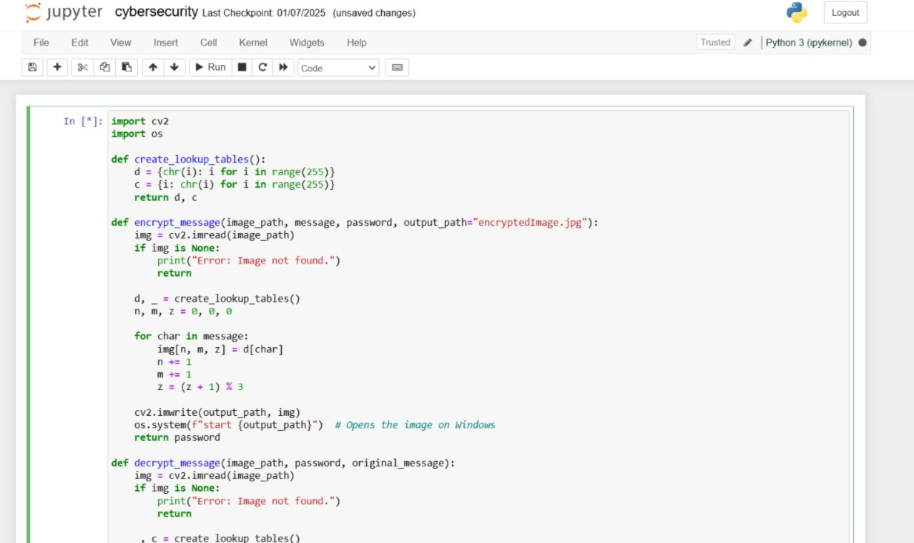
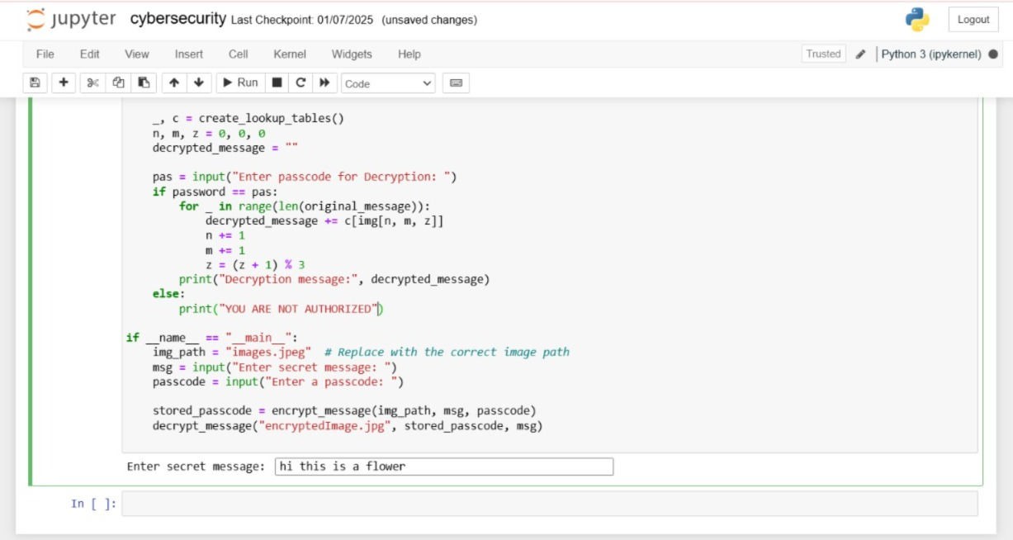
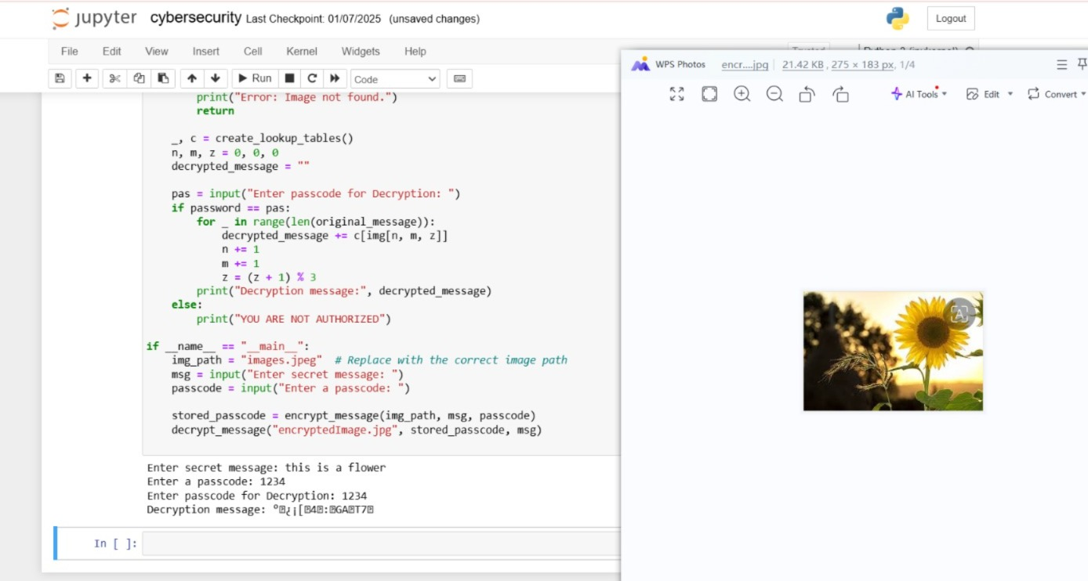
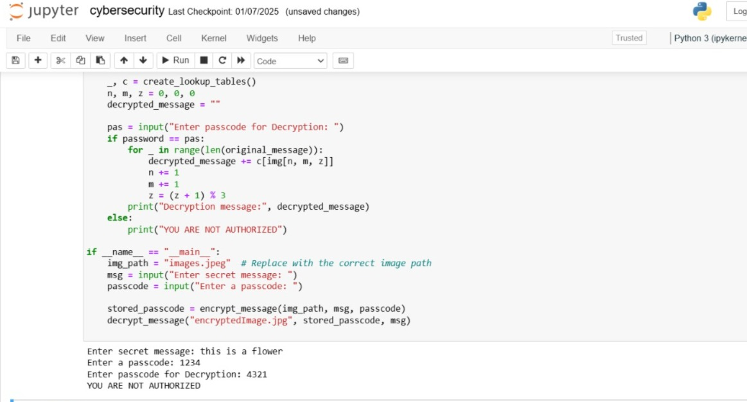
Results

Slide 8
Conclusion
In an era where data security is a growing concern, this project offers a simple yet effective way to embed secret messages within images using image steganography. By leveraging Least Significant Bit (LSB) encoding, the method ensures that messages remain invisible while allowing for secure and discreet communication. Unlike traditional encryption, this technique reduces the risk of detection, making it ideal for users who need a lightweight and easily accessible method for hiding information. With password protection for added security, this project provides a practical solution for secure data transmission without drawing unwanted attention.
quality.

Slide 9
GitHub Link
https://github.com/Kasturi3004/Image-Steganography

Slide 10
Future scope(optional)
Enhanced Security: Combine advanced encryption algorithms with steganography for an extra layer of protection.
Versatile File Support: Enable message hiding in audio, video, and document files alongside images.
AI-Powered Concealment: Utilize AI techniques to make hidden messages even harder to detect.
Seamless Accessibility: Develop a web or mobile app for secure and convenient message embedding and retrieval.
Optimized Storage: Improve algorithms to accommodate larger messages without compromising file quality.

Slide 11
THANK YOU

